Slide 1
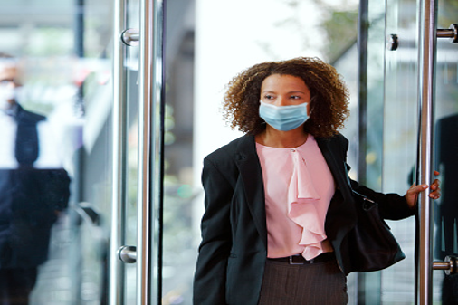
RETURN WITH CONFIDENCE
COVID-19 Guide
Updated Policies & Procedures // June 2021

Slide 2

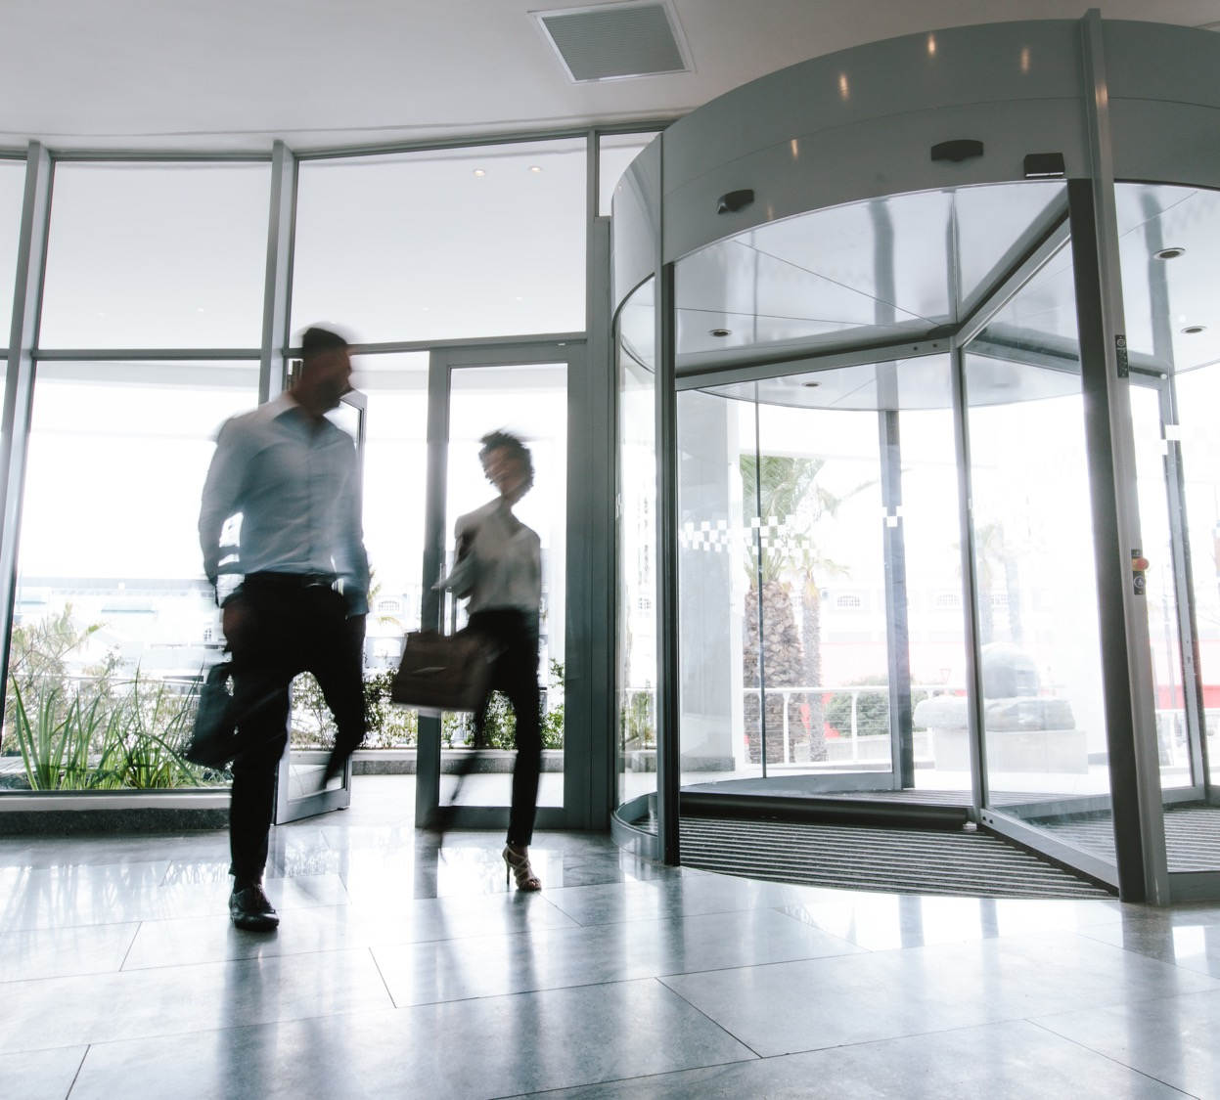
BACKGROUND
Since early March 2020, the building has been operating during regular business hours to allow for essential business employees to work safely in the their offices. Building operations had to be adjusted as most companies decided to allow most of their non-essential personnel to work from home.
This document serves as a resource for your company to use as you consider when and how to reopen your office at 7550 Wisconsin over the coming months. This plan outlines our re-entry plan for the safe return of our Clients, visitors, vendors, contractors, and others. It identifies operational and safety procedures and protocols that have been implemented.
We appreciate your continued personal efforts and cooperation during this difficult time. Our goal is to continue to provide you and your employees with a safe and comfortable work environment.
// Return With Confidence
2

Slide 3
WHAT WE HAVE DONE TO DATE
1
The building team has kept the building fully operational for our Clients. Building operations have been adjusted to ensure that they are consistent with the latest public health regulations. Please be assured that the building is open and prepared for occupancy.
Austerity measures have been implemented to conserve operating expenses. We appreciate that the pandemic has had dramatic economic consequences. In an effort to conserve operating expenses borne by our Clients, we have carefully reduced expenses while taking care to stay in conformance with lease requirements.
The fitness center and roof deck are open. The fitness center is open to Clients while our cleaning staff continues to perform heightened cleaning in high-touch areas. The roof deck is also open and available for Client events within Montgomery County’s guidelines.
We completed a third-party audit of our janitorial practices. To evaluate the efficacy of cleaning practices, the third-party evaluated high-touch surfaces such as countertops, door handles, and elevator buttons using adenosine triphosphate sampling and visual inspection based on APPA guidelines.
We have been carefully tracking the number and location of Clients in the building on a daily basis. This has allowed us to accurately predict the cleaning staff requirements for the building and the locations that are in need of cleaning on a daily basis.
6
All HVAC filters were recently changed and all building preventative maintenance requirements have been maintained.
We have been communicating with our Clients leading up to and during the stay-at-home mandate. We will continue to communicate with Clients on a regular basis with important and relevant information regarding building operations.
We have notified Clients of confirmed or suspected cases of COVID-19 within the building and have implemented appropriate protocols in the affected areas.
All service providers have been required to provide us with their COVID-19 employee procedures and best practices as well as adjustments to work protocols to prevent the spread of the disease.
We have closely followed the latest updates from federal, state, and city authorities and recommendations, as well as guidelines from the Centers for Disease Control (CDC), Environmental Protection Agency (EPA), American Society of Heating, Refrigerating and Air-Condition Engineers (ASHRAE), and other regulatory and public agencies.
We have earned UL’s Verified Health Building Mark. UL’s program is designed to demonstrate that buildings have excellent indoor air quality (IAQ) performance.
7
2
8
3
9
4
10
5
11
// Return With Confidence

Slide 4
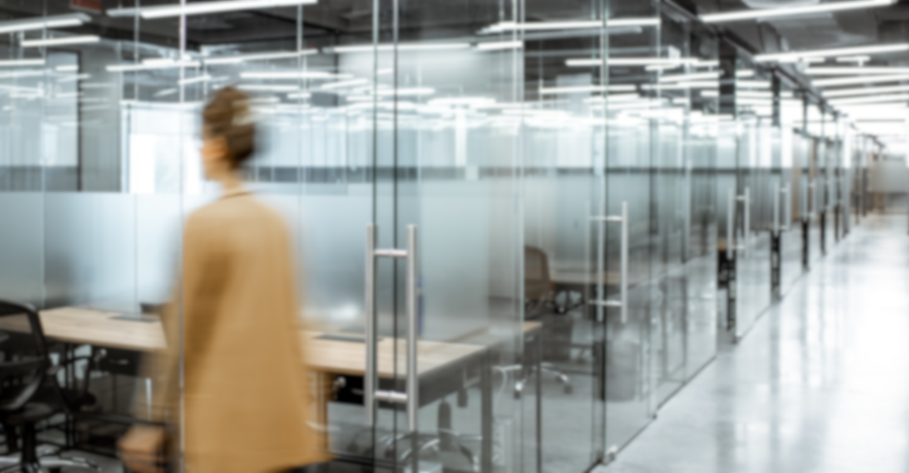
OUR PLAN FOR
7550 Wisconsin
The following information outlines the overall plan as well as prudent details of the re-entry plan for 7550 Wisconsin.
// Return With Confidence

Slide 5


BUILDING MASK POLICY
// Return With Confidence

Slide 6
BUILDING MASK POLICY
Following recent updates to local orders, vaccinated individuals will no longer be required to weak masks in common areas of the building. The building mask policy will state that “Masks are required in common areas except for fully-vaccinated individuals.” Common areas include the lobby, elevators, restrooms, and amenity spaces such as the fitness center and roof deck.
Masks will still be required for building personnel, contractors and delivery staff in common areas and Client suites.
The CDC recommends that individuals who are not vaccinated should continue wearing a mask in all settings.
// Return With Confidence

Slide 7


BUILDING PERSONNEL
// Return With Confidence

Slide 8

BUILDING PERSONNEL
All building staff have been provided with the appropriate level of PPE including face masks.
We will continue to require that building personnel wear masks in common areas and within Client suites.
We have communicated on a daily basis with building staff on appropriate procedures and protocols to prevent exposure to the virus.
If a staff member, or staff family member tests positive for COVID-19, we will practice non-discriminatory and CDC-based criteria to determine when it is safe for the staff member to return to work. Building staff have been instructed to stay home if they are ill.
// Return With Confidence

Slide 9
VENDOR MANAGEMENT & CONTRACTORS
// Return With Confidence

Slide 10

VENDOR MANAGEMENT & CONTRACTORS
All contractors and vendors entering the building are required to wear face protection.
Akridge requires all its vendors to submit a COVID-19 procedures compliance document prior to work being scheduled or completed. It is recommended Clients require their contracted vendors to do the same.
// Return With Confidence

Slide 11
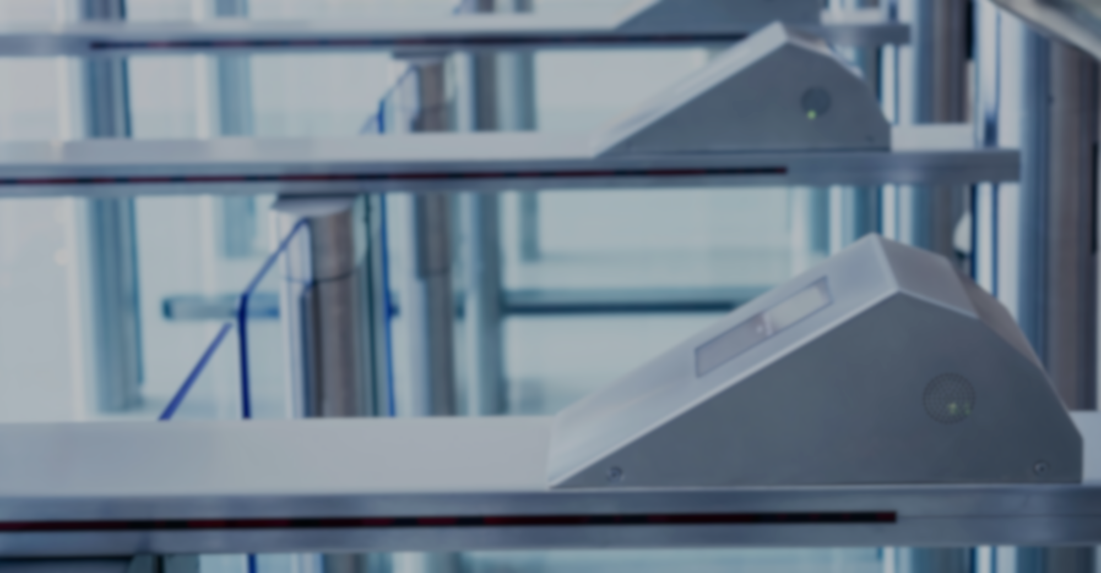

SECURITY & BUILDING ACCESS
// Return With Confidence

Slide 12
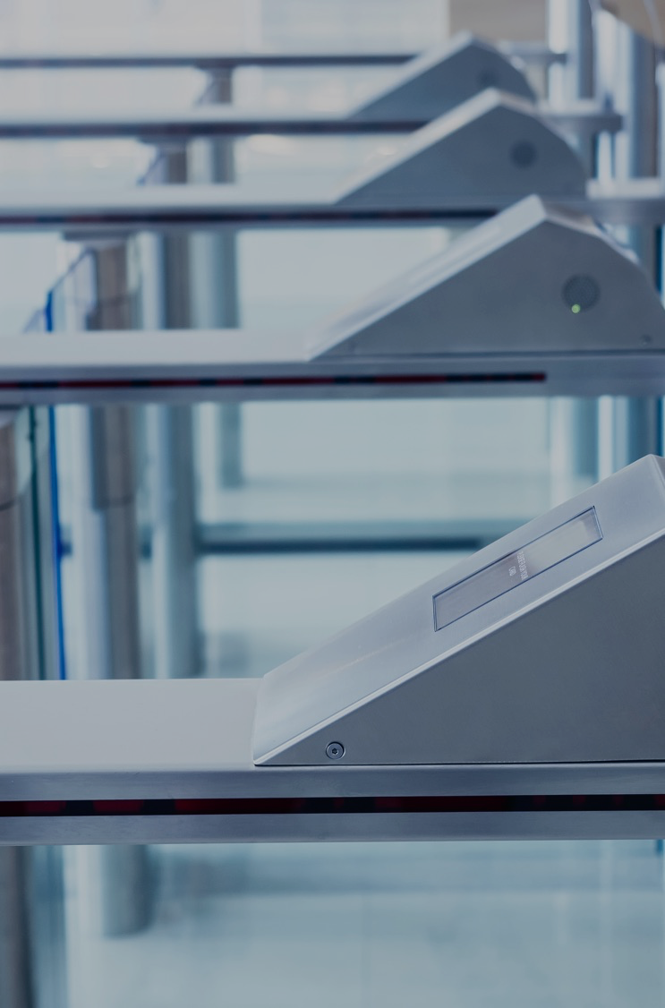
SECURITY & BUILDING ACCESS
All visitors must report to the lobby desk.
Plexiglass barriers have been installed at the security desk.
Hand sanitizer is available at building entry points.
// Return With Confidence

Slide 13
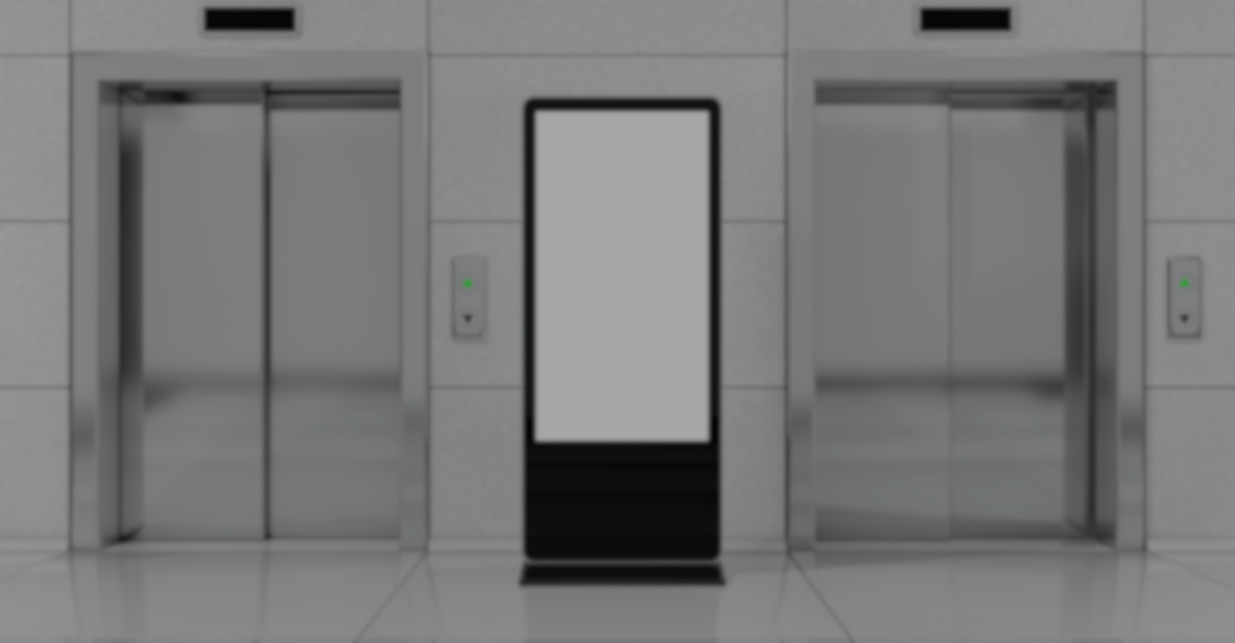

SIGNAGE
// Return With Confidence

Slide 14
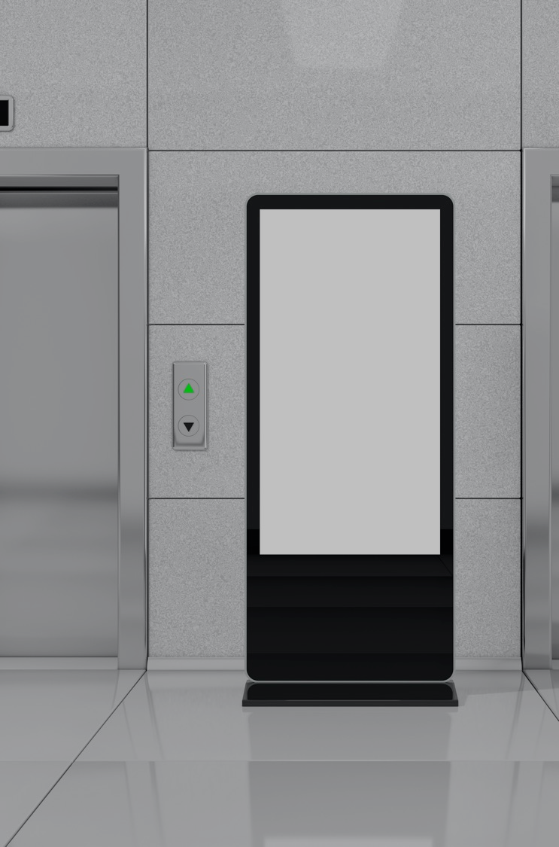
SIGNAGE
Consistent with CDC guidance, most social distancing and capacity-limiting signage has been removed.
New guidelines, recommendations, and policies have been clearly posted in the main lobby, loading dock, and parking valet area.
// Return With Confidence

Slide 15


CLEANING
CLEANING
// Return With Confidence

Slide 16
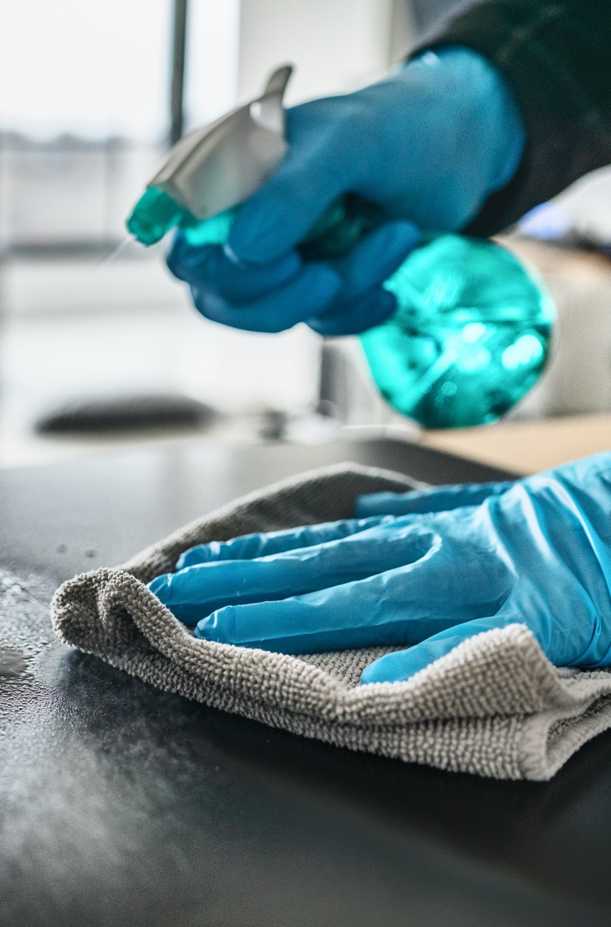
CLEANING
We completed a third-party audit of our janitorial practices. To evaluate the efficacy of cleaning practices, the third-party evaluated high-touch surfaces such as countertops, door handles, and elevator buttons using adenosine triphosphate sampling and visual inspection based on APPA guidelines
The janitorial contractor, Pioneer, are following EPA, CDC, and other government approved guidelines, recommendations, and directions for cleaning products, procedures, dwell times, and protocols. Products used by Pioneer are hospital grade and have been approved or recommended by the EPA and CDC.
Employees of Pioneer have received new or refresher training on cleaning protocols and proper use of disinfectants and have been supplied with the appropriate level of PPE.
We are closely monitoring occupancy levels of the building and as occupancy levels increase, cleaning staff levels will be modified appropriately. Cleaning schedules will also be closely monitored and may be adjusted to allow proper levels of cleaning at the appropriate times.
We have been routinely operating water systems, toilets, faucets, and floor drains to avoid the accumulation of biofilm and other bacteria.
The frequency of cleaning and use of disinfectant in high-touch common areas of the building, such as the atrium, security desk, elevator lobbies, elevator interiors, buttons and surfaces, restrooms, door knobs, switch plates, handrails, counters, and other frequently touched surfaces will remain at an increased level.
If a Client or visitor to Clients’ suites becomes ill or tests positive for COVID-19, it is recommended a deep cleaning of the Clients’ suite be performed at the Client’s expense.
// Return With Confidence

Slide 17
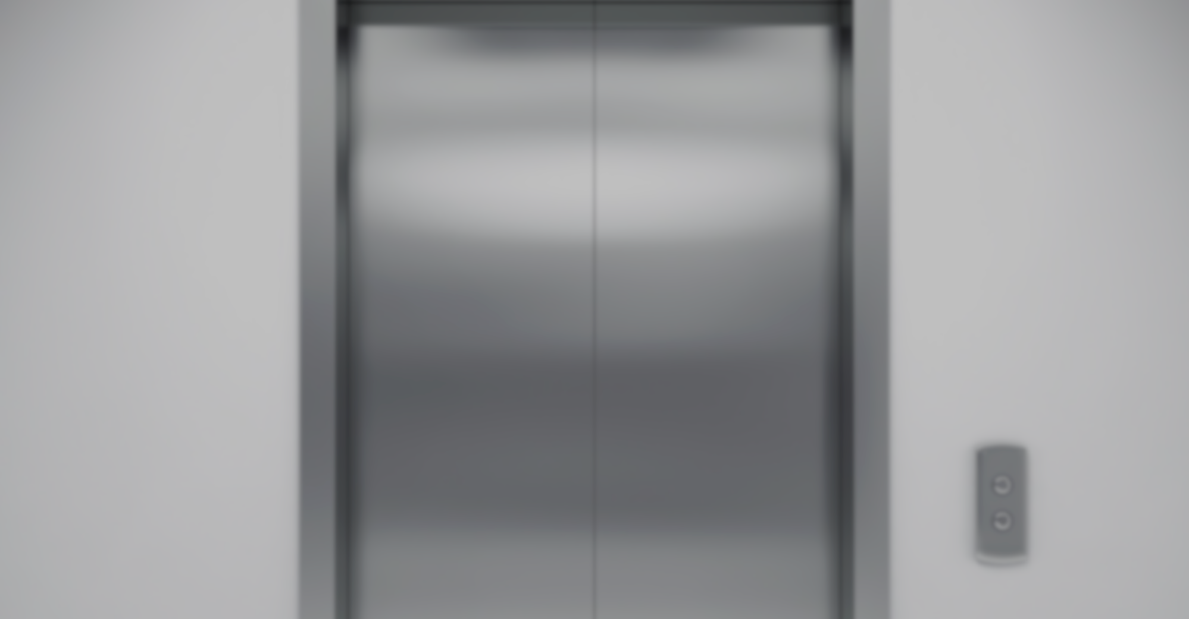

VERTICAL TRANSPORTATION
// Return With Confidence

Slide 18
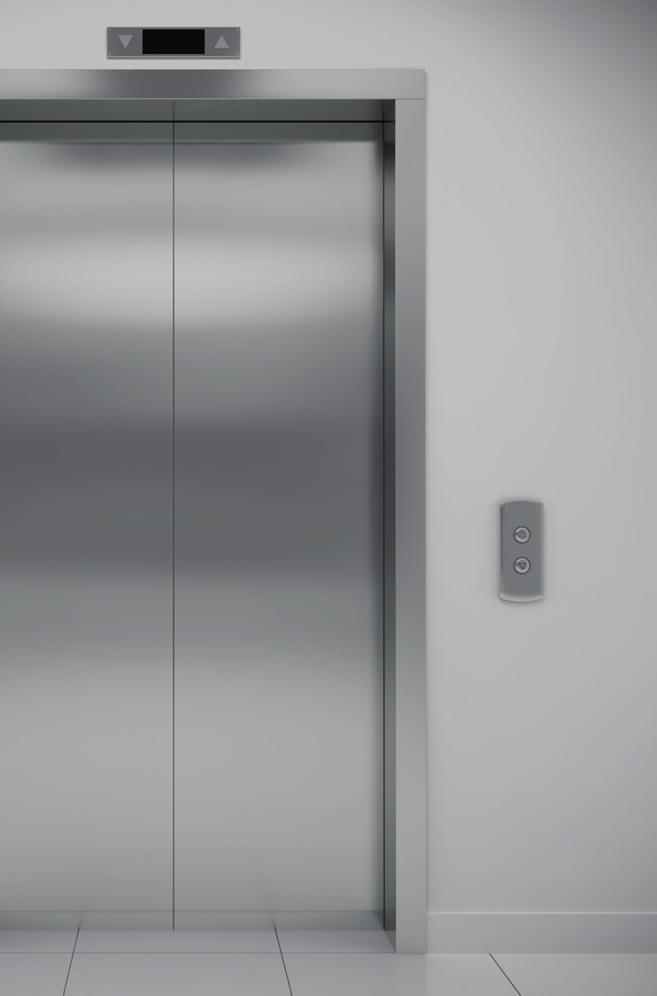
VERTICAL TRANSPORTATION
In accordance with updated local orders, the building will no longer enforce capacity limits in the elevator cabs.
Stairwells can be used to exit the building to limit travel in elevators.
Elevators are being cleaned with disinfectant throughout the day as well as in the evening.
Routine elevator maintenance has continually been performed.
// Return With Confidence

Slide 19


COMMON AREAS
// Return With Confidence

Slide 20



PENTHOUSE
The Penthouse is available for Client use.
LOBBY
Lobby events are permitted for Client use.
BIKE ROOM
The bike room remains open.
ROOF DECK
The roof deck remains open for Client use.
// Return With Confidence

Slide 21


FITNESS CENTER
// Return With Confidence

Slide 22

FITNESS CENTER
The fitness center is open for Client use.
All users are to wipe down equipment with disinfectant wipes after each use. Disinfectant wipes will be provided in the fitness center.
The showers and locker rooms remain open. Towel service is currently provided.
The workout area and locker rooms are cleaned nightly with the use of disinfectant.
// Return With Confidence

Slide 23


Indoor Air Quality & HVAC
// Return With Confidence

Slide 24


HVAC
As always, compliance with ASHRAE standards have been closely followed.
The fresh-air intake for the building complies with or exceeds ASHRAE standards.
We continue to use the highest level of MERV filters that the HVAC equipment can accommodate.
All filters have been and will continue to be changed on a regular basis.
Routine preventative maintenance has been and will continue to be performed.
Indoor Air Quality
The building recently earned the UL Verified Healthy Building for Indoor Air Mark.
UL’s program is designed to demonstrate that buildings have excellent indoor air quality (IAQ) performance.
To achieve the UL Healthy Building for Indoor Air Verification Mark, the building participated in an extensive audit and underwent a site visit that included visual inspections and performance testing.
// Return With Confidence

Slide 25


CONSTRUCTION
// Return With Confidence

Slide 26

CONSTRUCTION
There is currently no construction projects underway in the building.
Moving forward, all pre-established building rules and regulations related to construction will continue to apply to future work.
The contractors will be instructed to ensure that all of its employees and the employees of all subcontractors strictly adhere to building policies. All construction workers must wear face protection at all times.
If you observe that construction workers are not complying with policies or not wearing face protection, please contact your property manager.
The contractors performing work will be required to provide their COVID-19 compliance procedures.
If an employee or vendor of a contractor tests positive for COVID-19, you will be informed.
If an employee or vendor of a contractor tests positive for COVID-19, the contractor will be responsible for ensuring that the proper level of disinfectant cleaning of the affected areas occurs.
If an employee or vendor of a contractor tests positive for COVID-19, we may require the work to be suspended to allow for the appropriate quarantine period.
// Return With Confidence

Slide 27


PARKING
// Return With Confidence

Slide 28

PARKING
The garage hours have been modified. The garage is operational from 8 am to 5 pm. Monthly parkers will continue to have 24/7 access.
The garage remains a self-park operation
// Return With Confidence

Slide 29


COMMUNICATION
// Return With Confidence

Slide 30

COMMUNICATION
We will continue to communicate with you frequently. We expect circumstances to change, and we will do our best to keep you updated.
Updates with changes to our protocols will be posted on the building website: https://7550wisconsin.com/toc.cfm
Encourage your staff to sign up for our instant alert notifications through Electronic Tenant Solutions. This allows us to transmit emergency information to many people at one time. We promise not to spam you! This system is used only to transmit relevant or emergency information in a timely manner. Please visit https://7550wisconsin.com/main.cfm?sid=introduction&pid=ccenter to sign up!
Please provide us with any changes to the emergency contacts within your organization.
// Return With Confidence

Slide 31


WHAT YOU CAN
DO TO HELP
1
We appreciate your patience. We are learning and adjusting our plan as circumstances change and new information becomes available.
Share this information with your staff so that they will know what to expect if they return to work.
Please reach out to us if you need assistance. We are here to help. Your input and suggestions are valuable. We want to work closely with you to ensure we are providing you and your employees with a safe and comfortable work environment.
2
3
// Return With Confidence

Slide 32


CLIENT
RECOMMENDATIONS
// Return With Confidence

Slide 33
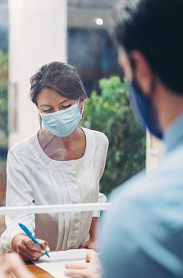
CLIENT RECOMMENDATIONS
STAFFING AND VENDOR MANAGEMENT
Akridge takes each employee’s temperature and ask them to self-certify that they are free of symptoms. We highly recommend that you consider a policy to take staff temperatures upon entering your suite. These policies are most effective when all Clients within a building enact them for their employees.
Strictly enforce health policies with all employees and vendors.
Limit contractor work to essential only.
ARCHITECTURAL
Install an acrylic separator at reception.
Engage with an architect or furniture consultant to change open work areas.
CLEANING
Provide guidance to staff to disinfect their work areas including office doors and light switches.
The building cleaners deep clean the common areas but do not disinfect inside Client suites except high-touch surfaces.
Procure and install supplies to support good hygiene and cleaning practices.
// Return With Confidence

Slide 34
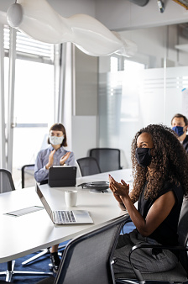
CLIENT RECOMMENDATIONS
MEETING SPACES
Establish policies for meeting spaces and common areas.
ADMINISTRATIVE
Update visitor policies
Consider establishing a reservation system.
Consider rules regarding use of kitchen.
Consider hiring a certified industrial hygienist to perform a health sampling of your space.
// Return With Confidence

Slide 35


RESOURCES
// Return With Confidence

Slide 36

RESOURCES
As you prepare your reentry plan, you may consider having your space evaluated by an architect. We can provide the names of trusted architects to you. One recommendation is as follows:
  Ania Leeson
  OTJ Architects
  aleeson@otj.com
  202.621.1353
We are happy to provide resources for social distancing signage within your space. One signage recommendation is as follows:
  Guy Brami
  Gelberg Signs
  guy@gelbergsigns.com
  202.882.7733 x222
The following group has been most helpful with plexiglass installations:
  Agam Group
  Kayla Gott
  kgott@agam.com
  443.459.5608
// Return With Confidence

Slide 37
PROPERTY MANAGER INFORMATION
BUILDING:
CONTACT:
PHONE:
EMAIL:
7550 Wisconsin
Alex Kirby
717.343.6048
akirby@akridge.com
// Return With Confidence

Slide 38
Thank you for safely returning to the office in a post-COVID-19 world.
Learn more by visiting our website: www.akridge.com
// Return With Confidence

